Slide 1



DATA STRUCTURES AND ITS APPLICATIONS
Graph Traversal Methods
Sandesh B. J
Department of Computer Science & Engineering

Slide 2


DATA STRUCTURES AND ITS APPLICATIONS
Graph Traversals Methods
Sandesh B. J
Department of Computer Science & Engineering

Slide 3
DATA STRUCTURES AND ITS APPLICATIONS
Graph Traversal Methods - Topics
Why we need to traverse the graph?
Traversing the graph using different techniques
  Depth First Search and Breadth First Search Traversal
Algorithms for Depth First and Breadth First Search Traversal

Slide 4
DATA STRUCTURES AND ITS APPLICATIONS
Graph Traversals
Graph traversal(also known as graph search) refers to the process of visiting/investigating (checking or updating) each vertex of the graph in some systematic order -Wiki
Traversal can start in any arbitrary vertex
Traversals are classified by the order in which the vertices are visited
Methods to Traverse the Graph
Depth First Search
Breadth First Search
Notes:
In tree traversal, we had a root vertex with which we generally started, in graphs, we often do not have any
One vertex singled out as special, therefore the traversal may start at any arbitrary vertex.
Although there are many possible orders for visiting the vertices of a graph, two methods are of particular
importance
Al

Slide 5
DATA STRUCTURES AND ITS APPLICATIONS
Depth first search (DFS)
Visits all the nodes related to one neighbour before visiting the other neighbours and its related nodes. Once it reaches dead end, it backtracks along previously visited node and continue traversing from there.
Analogues to pre-order traversal of an ordered tree
Uses stack behaviour, hence implemented using recursive algorithm
Notes:
A depth-first search (DFS) is an algorithm for traversing a finite graph.
DFS visits the child vertices before visiting the sibling vertices;
that is, it traverses the depth of any particular path before exploring its breadth.
A stack (often the program's call stack via recursion) is generally used when implementing the algorithm.

Slide 6
DATA STRUCTURES AND ITS APPLICATIONS
Depth First Search Traversal
DFS traverse the depth of the graph, until it cannot go any
further at which point it backtracks and continues
1
3
2
4
5
6
V = { 2 }
W= { 4, 5, 6 }
7
Traversal order : 1 , 2, 4 , 7, 3, 5, 6
Notes:
Suppost the traversal has just visited the avertex 2, and let 4, 5, 6 be the vertices adjacent to v, then we shall next visit
4 and keep 5 and 6 waiting. After visiting 4, we traverse all the vertices to which it is adjacent before returning to
Traverse 5 and 6

Slide 7
DATA STRUCTURES AND ITS APPLICATIONS
Depth First Search Traversal
1
2
3
4
5
6
7
8
9
1
2
3
6
5
7
4
8
9
Notes:
I am going to start our dept first search using arbitrary node 1 as source. Now we are going to pick arbitrary node to go to, so from node
Zero we are going to node 2. From node 2 we have two choice node 3 and node 5 as node 1 is already visited. We visit node 3 and then node 6
We donot want to visit alerady visited node or nodes currently being visited. So we need to backtrack.

Slide 8
DATA STRUCTURES AND ITS APPLICATIONS
Difficulties in the graph traversals
Graph may contain cycles
  Traversal algorithm may reach the same vertex second time.
  To prevent the infinite recursion , we introduce Boolean
  valued array visited
  Set the visited[v] to true once node v is visited
  Check the visited[w] before processing any node w
Graph may not be connected:
  Traversal algorithm may fail to reach all the nodes from a
  single starting point
1
4
5
6
2
3
7
Notes:
In case there exists cycle in a graph, for example the node 1, 4 and 3 form a cycle. Then the algorithm may visit the same vertex
Second time. For instance, let us traverse the graph using dfs traversal by considering node 1 as source. From node 1 we can select
Arbitrary vertex 4, from 4 we visit node 3. From node 3 we may visit the node 1 for the second time. From 1 we may visit the node
4 once again froming a infinite loop.
The other issue is when graph is not connected. In case graph is not connected, and we start with a arbitrary node in one of the connected component of the
Graph. Then algorithm will be able to visit only the nodes in this connected component leaving the nodes in other connected components unvisited. This makes us to start the graph traversal by selecting one node in each connected component.

Slide 9







DATA STRUCTURES AND ITS APPLICATIONS
DFS Traversal – Using Stack
Source
1
2
3
3
5
6
6
7
4
5
4
2
1
7
Stack
1
2
3
4
5
6
7
Visited
0 | 0 | 0 | 0 | 0 | 0 | 0
1
1
1
1
1
1
1
Visited nodes

Slide 10
DATA STRUCTURES AND ITS APPLICATIONS
Breadth first search (BFS)
Explores all the neighbour nodes in first level from an arbitrary node, before moving to next level of neighbouring nodes.
Uses Queue behaviour

Slide 11
DATA STRUCTURES AND ITS APPLICATIONS
Breadth First Search Traversal
Analogous to level-by-level traversal of ordered tree
1
2
3
4
5
6
V = { 2 }
W= { 4, 5, 6 }
7
Traversal order : 1 , 2, 3, 4, 5, 6 , 7

Slide 12
DATA STRUCTURES AND ITS APPLICATIONS
Breadth first search Traversal
1
2
3
4
5
6
7
8
9
1
2
4
5
3
7
6
8
9

Slide 13
DATA STRUCTURES AND ITS APPLICATIONS
BFS Traversal – Using Queue
source
A
front
B
C
D
A`
C
E
B
Queue
D
E
Remove_Q
F
Visited
1
0 | 0 | 0 | 0 | 0 | 0
1
1
1
1
A
B
C
D
E
F
Visited nodes
A
B
C
D
E

Slide 14
DATA STRUCTURES AND ITS APPLICATIONS
BFS – Traversal – Using Queue
source
A
front
B
C
C
D
E
F
Queue
D
E
Remove_Q
F
Visited
1
1
0 | 0 | 0 | 0 | 0 | 0
1
1
1
1
A
B
C
D
E
F
Visited nodes
A
B
C
D
E
F

Slide 15
DATA STRUCTURES AND ITS APPLICATIONS
DFS - Algorithm
Algorithm DFS (Graph G )
//Implements DFS traversal for given graph
// Input Graph G = (V, E)
//Output Graph G with vertices marked as visited
mark each vertex in V with 0 as a mark of being “unvisited”
for each vertex v in V do
if v is marked with o
dfs(v)
dfs(v)
// visits recursively all the unvisited vertices connected to
vertex v by a path
For each vertex w in V adjacent to v do
if w is marked with o
mark w as visited
dfs(w)
Courtesy: “Introduction to Design and Analysis of Algorithms” By Anany Levitin

Slide 16
DATA STRUCTURES AND ITS APPLICATIONS
BFS - Algorithm
Algorithm BFS (Graph G )
//Implements BFS traversal for given graph
// Input Graph G = (V, E)
//Output Graph G with vertices marked as visited
mark each vertex in V with 0 as a mark of being “unvisited”
for each vertex v in V do
if v is marked with 0
bfs(v)
Courtesy: “Introduction to Design and Analysis of Algorithms” By Anany Levitin

Slide 17
DATA STRUCTURES AND ITS APPLICATIONS
BFS - Algorithm
bfs(v)
// visits recursively all the unvisited vertices connected to
vertex v by a path
While the queue is not empty
for each vertex w in V adjacent to front vertex do
if w is marked with 0
mark w as visited
add w to queue
remove the front vertex from the queue
Courtesy: “Introduction to Design and Analysis of Algorithms” By Anany Levitin

Slide 18
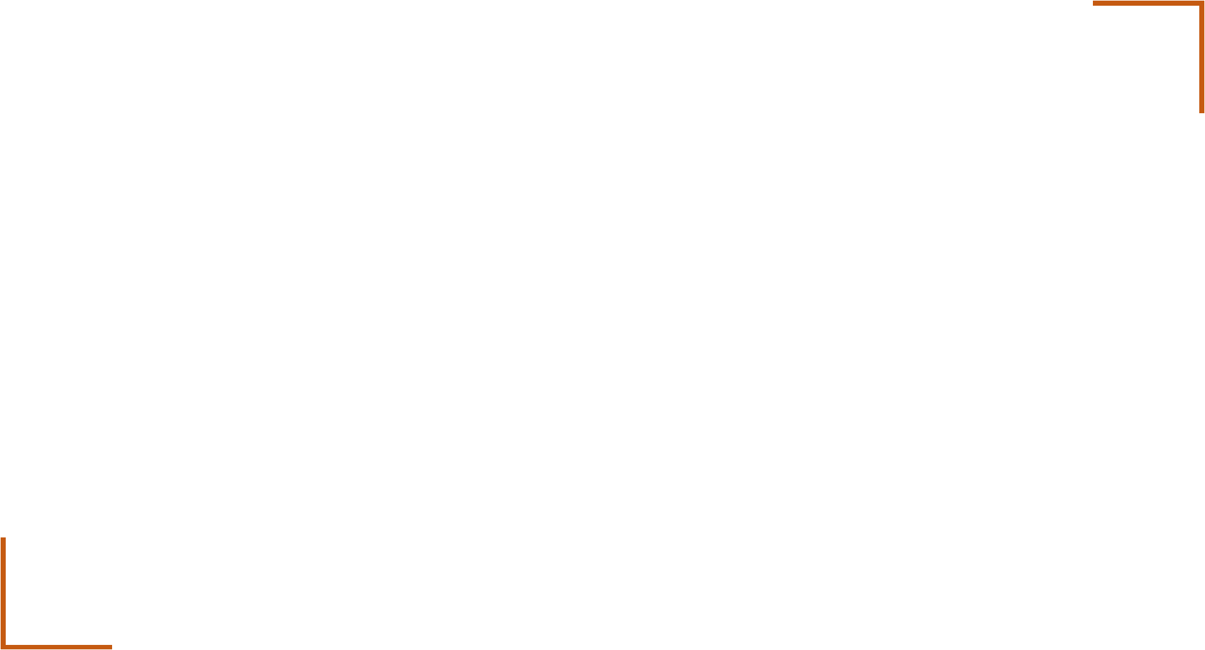
THANK YOU
Sandesh B. J
Department of Computer Science & Engineering
sandesh_bj@pes.edu
+91 80 6618 6623

